Slide 1
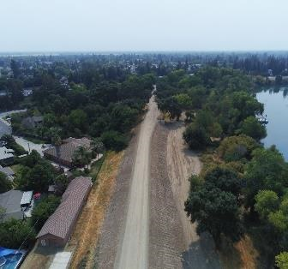
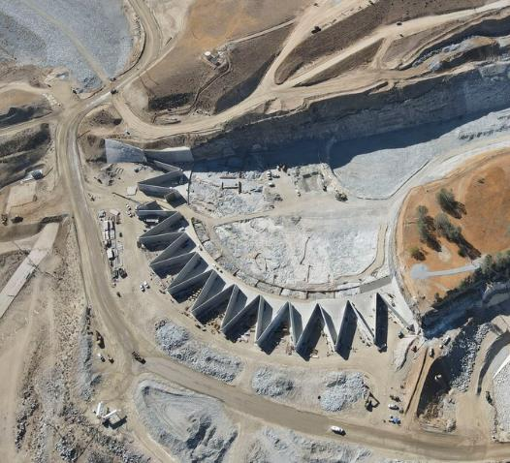
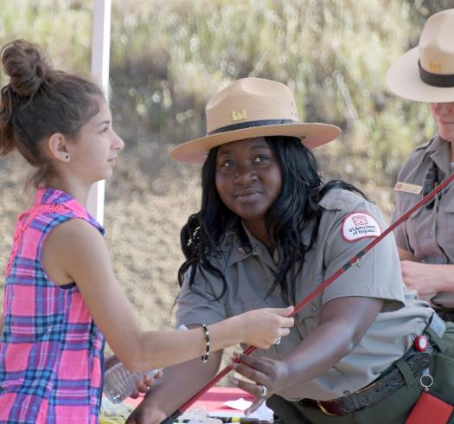
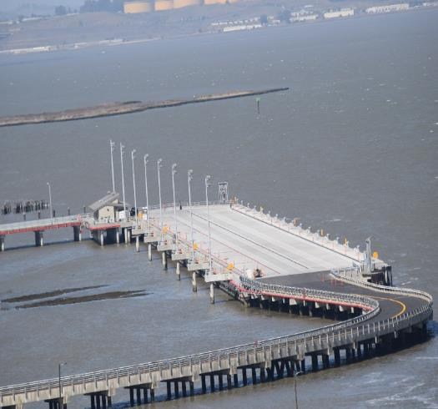
Sacramento District
Business opportunities open house (BOOH)
LTC Dianna Lively
Deputy District Commander
Sacramento District
MAR 2024
Controlled by: USACE
Controlled by: SPK Executive Office
CUI Categories: BUDG
Limited Dissemination Control: FED ONLY
POC: J. Payne, 916-557-7521

Slide 2
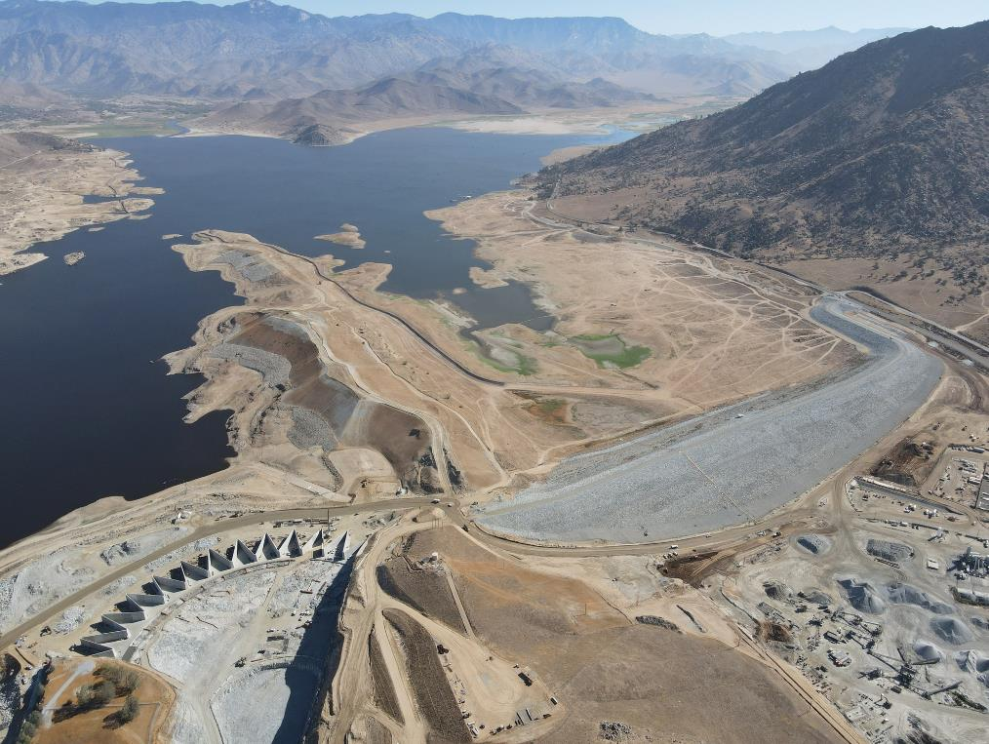
South Pacific Division Vision
Delivering Bold Solutions to Serve and Strengthen all Communities
Isabella Auxiliary Dam, Kern County, CA

Slide 3
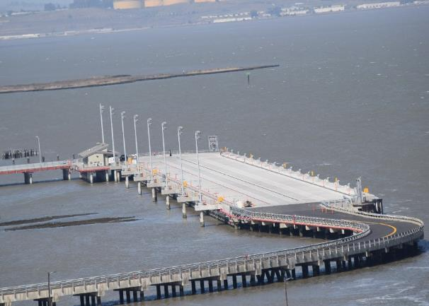
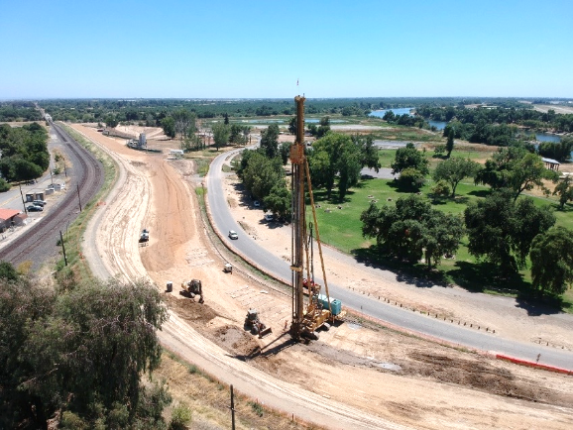
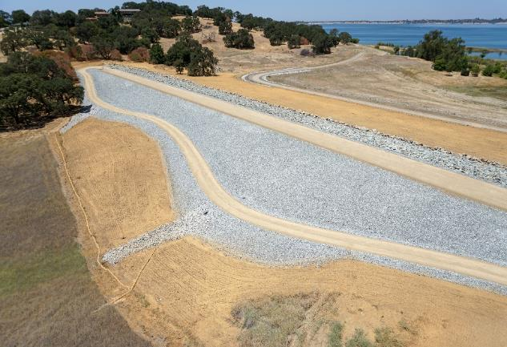
Sacramento District Mission
We are a diverse group of dedicated professionals committed to protecting lives and property and serving our nation through partnering and collaboration. We strive to deliver enduring, innovative, and sustainable solutions to our community.
Military Ocean Terminal Concord, CA
Marysville Ring Levee Project, CA
Folsom Dam Raise Project, Dike 8, Folsom CA

Slide 4
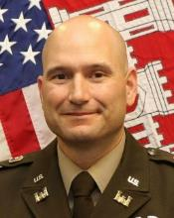
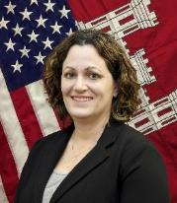
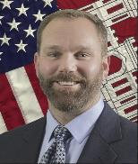
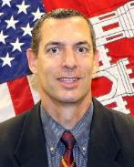
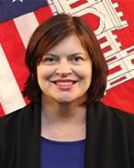
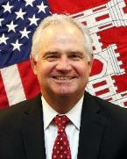
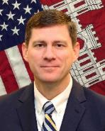
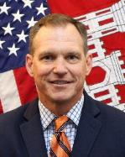
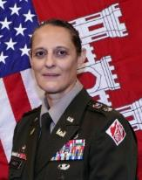
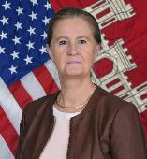
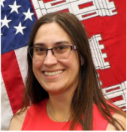
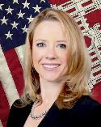
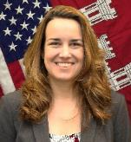
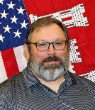
SACRAMENTO DISTRICT LEADERSHIP
Commander
Deputy for Project Management (DPM)
Engineering
Construction
Planning
Operations
Real Estate
Regulatory
Ms. Beth Salyers
Mr. Mark DeRocchi (Rock)
Mr. Steve Gladwell
Ms. Alicia Kirchner
Mr. Randy Olsen
Mr. Adam Olson
Mr. Michael Jewell
COL Chad Caldwell
Deputy Commander
Contracting
Counsel
Resource Management (Acting)
Sacramento Basin Project Center
Dam Safety Production Center (Acting)
Ms. Colette Carrizales
Ms. Amanda Fuller
Ms. Elizabeth Henson
Ms. Kristine
Des Champs
LTC Dianna Lively
Mr. Michael Arles
Over 1,100 military and civilians serving the Nation… since 1929.

Slide 5
SACRAMENTO DISTRICT STRUCTURE
Commander
General & Admin Staff
Counsel
Contracting
Executive Office
Resource Management
Public Affairs
Small Business
Internal
Review
EEO
Safety
Security
Logistics
OCIO/G6
Programs & Project Management Division
Planning
Division
Engineering Division
Construction Division
Operations Division
Real Estate Division
Regulatory Division
Water Resources
Design - CW
Support
Support
Leasing Branch
California Delta
Sacramento Basin Project Center
Civil Works
Design - MIL
Levees & Channels
Environmental Resources
Hydrology & Hydraulics
Military
Northern Branch
California North
Folsom Program
Air Force
Civil Works
Readiness
Southern Branch
California South
Army/ HTRW/IIS
Environmental Engineering
Geotechnical Engineering
DVA
Northern Operations
Natomas
Southern Operations
Regional Appraisal Center
Nevada
American River Common Features 2016
Programs & Project Support
Engineering Support
SPD Dam Safety Production Center
Utah
Department of Veterans Affairs
Special Projects
Key:
Execution Function
Support Function
National Organizations

Slide 6
Sacramento District Overview
Over 1,100 Team members serving a population of 11 million people
4 OCONUS Deployed Employees
27 Construction Offices
4 Regulatory Offices
3 MEGA Projects – American River Common Features (ARCF 2016), DVA Alameda CBOC & National Cemetery, DVA Livermore Campus (Realignment & Closure)
Manage Recreation Facilities at 10 Projects; 2.35 Million Visits Annually
Operate & Maintain 17 Dams and Reservoirs
19 Army & Air Force Programs/Installations
Significant Hazardous, Toxic and Radioactive Waste (HTRW) Program
South Pacific Division Dam Safety Production Center
Serving 8 States (Primarily CA, NV, UT, CO)
90 Federally-recognized Tribes
46 Members of Congress
OR
ID
WY
NV
UT
CO
CA
AZ
NM
TX
Program Boundaries
Civil Works Construction
Military Construction Program
Regulatory
SPN Boundary (SPK MIL Design)
SPL Boundary (SPK MIL Design)
SPA Boundary

Slide 7
programs and project management

Slide 8
Civil Works Program
California
  Feasibility Study
  Planning, Engineering, and Design (PED)
  Construction
  Mega Projects
  Supplemental Projects
  P.L. 84-99
  Floodplain Management Services (FPMS) & Planning Assistance to States (PAS)
  Tribal Partnership Study
  Lake Tahoe
  Silver Jackets
  Restoration of Abandoned Mines (RAMS)
Nevada
  PED
  FPMS & PAS
  Lake Tahoe
  Silver Jackets
  RAMS
Utah
  FPMS & PAS
  Silver Jackets
Colorado
  Silver Jackets
OR
ID
WY
NV
UT
CO
CA
AZ
NM
Civil Works

Slide 9
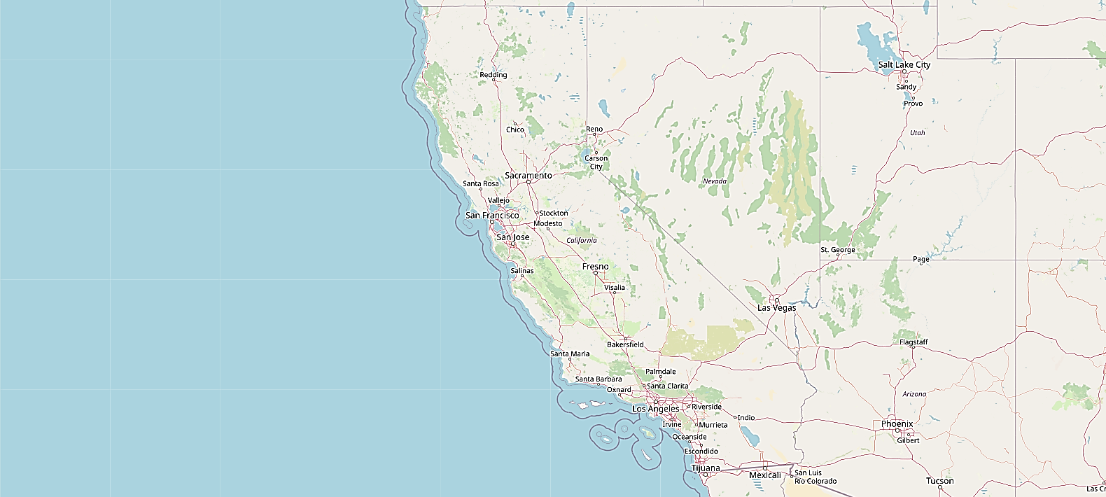
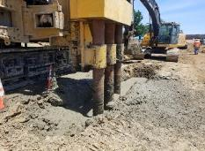
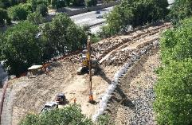
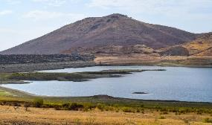
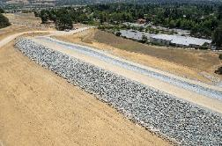
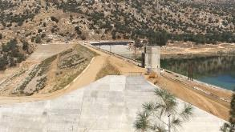
Civil Works program
West Sacramento
Total = $1.2B
Yuba River Basin - (Marysville Ring Levee)
Supp. = $13.5M
Total = $160M
Lower San Joaquin
Total = $1B+
Levee Upgrades, Natomas Basin
Sacramento Weir Enlargement
ARCF – 2016
Supp. = $1.57B
Total = $1.57B
Sacramento
Tule River -
(Richard L. Schafer Dam)
Supp. = $135.5M
Folsom Dam Raise
Supp. = $216M
Total = $373M
Isabella Dam
Supp. = $258M
Total = $631.8M
Civil Works Program | MILCON & SRM
24 | $520M
25 | $410M
26 | $370M
Dam Safety
Flood Damage Reduction

Slide 10
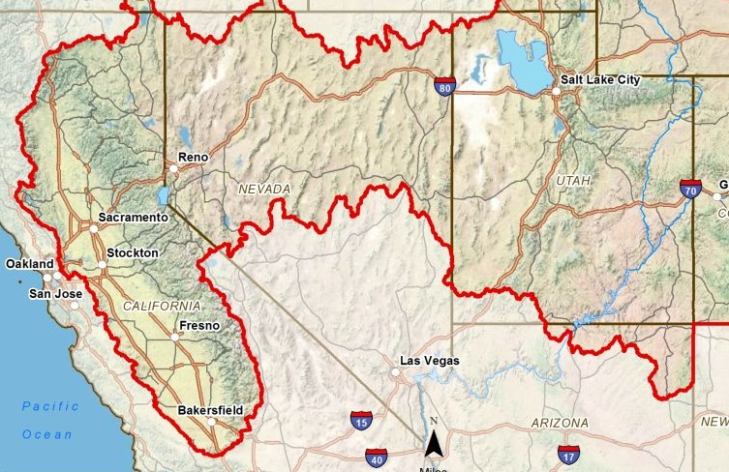
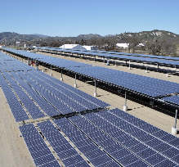
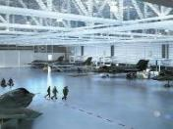
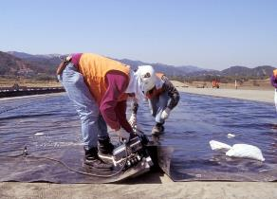
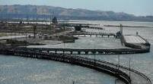
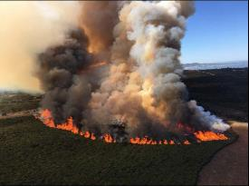
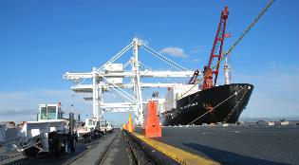
Military program
Military Construction
Sustainment, Restoration, Modernization
Base Realignment and Closure - Environmental Restoration
Formerly Used Defense Sites
Environmental Quality
Installation Restoration Program/
Military Munitions Response Program
Interagency and International Services (EPA, DHS, DVA, DOI, DOA, DOJ)
Defense Depot Hill, UT
MIL Boundary
Utah Test & Training Range, UT
Hill AFB, UT
Toole Army Depot, UT
CW Boundary
Sierra Army Depot, CA
Dugway Proving Grounds, UT
Camp Williams, UT
Beale AFB, CA
UC Davis, DOA
Travis AFB, CA
Hawthorne Army Depot, NV
DOE LMO, Grand Junction
Military Ocean Terminal Concord, CA
Riverbank Army Ammunition Plant, CA
Defense Depot
San Joaquin, CA
Camp Parks, CA
Fry Canyon, BLM
FY | MILCON & SRM | ENV | IIS
24 | $187M | $116M | $114M
25 | $537M | $116M | $10M
26 | $500M | $143M | $10M
Fort Ord, CA
Presidio of Monterey, CA
Ft Hunter Liggett, CA
Ft Irwin, CA
Camp Roberts, CA
Army Installations
Air Force Installations
Closing Installations
IIS Federal Agencies

Slide 11
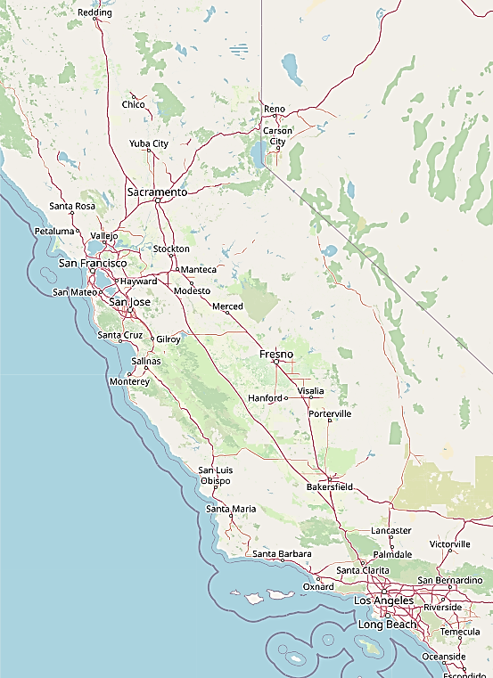
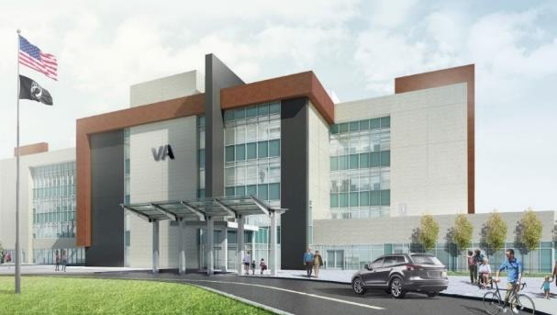
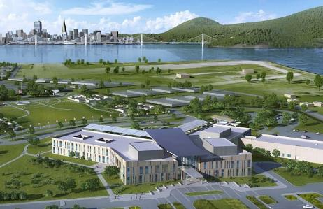
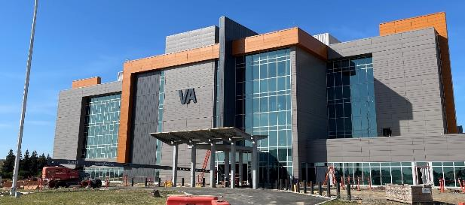
Department of Veterans Affairs Program
DVA Program (Anticipated Construction Awards) | MILCON & SRM
FY24 | $32M
FY25 | $238M
FY26 | $30M
Reno
Sacramento
San Francisco
Stockton
Livermore Realignment & Closure, Livermore//Stockton/Fremont, CA
Community Based Outpatient Clinic (CBOC) and Columbarium, Alameda, CA
Stockton CBOC current construction at the future Department of Veterans Affairs Clinic
Notes:
FY24: Stockton ELB and CLC award
FY25: Fremont CBOC award

Slide 12
Points of contact
PPMD:
Pam Castens - Civil Works Branch, (916) 557-5140, Pamela.G.Castens@usace.army.mil
Arianna Raymundo – Military Programs Branch, (916) 557-76748, Arianna.f.raymundo@usace.army.mil
Construction:
Robert Caputo – Military Area Office Engineer, (916) 649-0133 x3004, Robert.l.Caputo@usace.army.mil
Kylan Kegel – Civil Works Area Office Engineer, (916) 557-7775, kylan.a.kegel@usace.army.mil
Operations:
Zeffy Ruvalcaba – Management Support Branch, (916) 557-7646, Zeferina.J.Ruvalcaba@usace.army.mil
Planning:
Kevin Harper – Environmental Resources Branch (602) 315-3225 Marshall.K.Harper@usace.army.mil
Kim Carsell – Water Resources Branch (916) 557-7635, Kimberly.M.Carsell@usace.army.mil
Safety Office:
Curtis Morris – Safety Chief (916) 557-5358, Curtis.D.Morris@usace.army.mil

Slide 13
Contracting

Slide 14
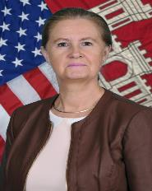
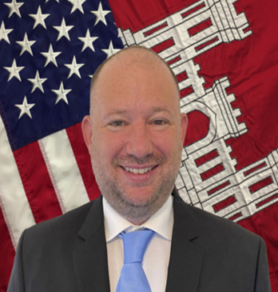
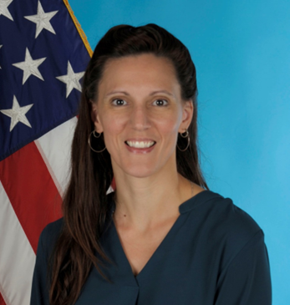
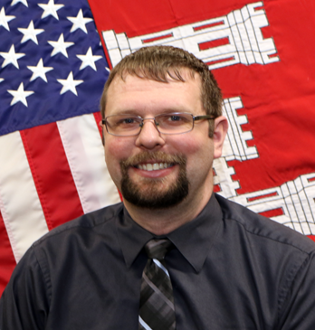
leadership
Dayon (Tre) Santos Rachel Kinney Dan Czech
Acting Deputy Chief, Contracting Acting Chief Chief
Business Oversight Construction Branch Service and Supply
Branch Chief Branch
Ms. R. Colette Carrizales
Division Chief, Contracting

Slide 15
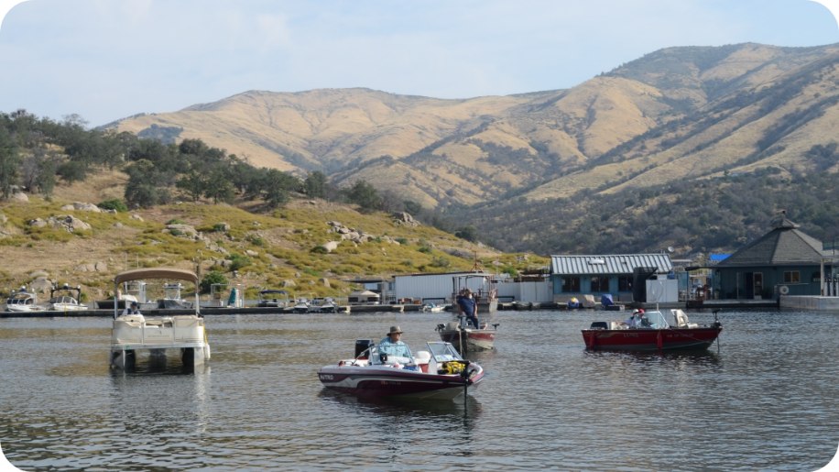
mission
Deliver innovative contract solutions that meet the needs of our Military and Civil customers and partners. Ensure quality products, facilities and services, reasonably priced and delivered on time.

Slide 16
TOP 5 DIVISION PRIORITIES
Hill Air Force Base, Utah
Department of Veterans Affairs
PFAS
Districts’ Military and Civil Works Missions
Growing and Sustaining the Contracting Workforce

Slide 17
Contracting toolbox
Government Purchase Card Program
Simplified Acquisition Procedures
Indefinite Delivery/Indefinite Quantity Contracts
Design-Build (DB) Multiple Award Task Order Contracts
A-E Contracts
Service, Environmental and Commercial Item Contracts

Slide 18
MATOC contracts & capacities
DB/DBB Construction
  Dam Maintenance and Repair $30M
Architect-Engineering
  Civil/Dam Safety - Large Business - $110M
  Vertical Design - $99M
  Civil Design - Small Business - $20M
  Military Design - Small Business - $9.9M
  Surveying - Large Business - $9.8M
  Surveying - Small Business - $5M
Environmental
  Planning - $40M
  FUDS - $45M
  ORAP - $49.9M
Other Services
  Mitigation and Vegetation - $49.9M
  Drilling Services - $9.9M

Slide 19
Future MATOCs
Geotech Design – Large and Small Business
Vertical Design – Large Business
General Construction – Large and Small Business
Construction Phase Services – Large and Small Business
Hydrology and Hydraulic – Size TBD
Munitions and Explosives of Concern – Size TBD

Slide 20
Execution Statistics: FY20 – FY23

Slide 21
Points of contact
Sacramento District Contracting Division and Small Business Office Information
  Contracting Division Chief
    Colette Carrizales R.C.Carrizales@usace.army.mil
  Contracting Deputy Division Chief (Acting)
    Dayon (Tre) Santos Dayon.T.Santos2@usace.army.mil
  Construction Contracting Branch Chief
    Rachel Kinney Rachel.Kinney@usace.army.mil
  Services and Supply Branch Chief
    Daniel Czech Daniel.E.Czech@usace.army.mil
Sacramento District Deputy (Acting), Office of Small Business Programs
  Dennis Wagner USACESacramentoSmallBusiness@usace.army.mil
  To find projects, announcements and Sources Sought opportunities please go to the www.sam.gov
  To locate Sacramento District opportunities please enter “W91238” in the Keyword/Solicitation # search field.
  Follow us on Facebook: https://www.facebook.com/sacramentodistrict/

Slide 22
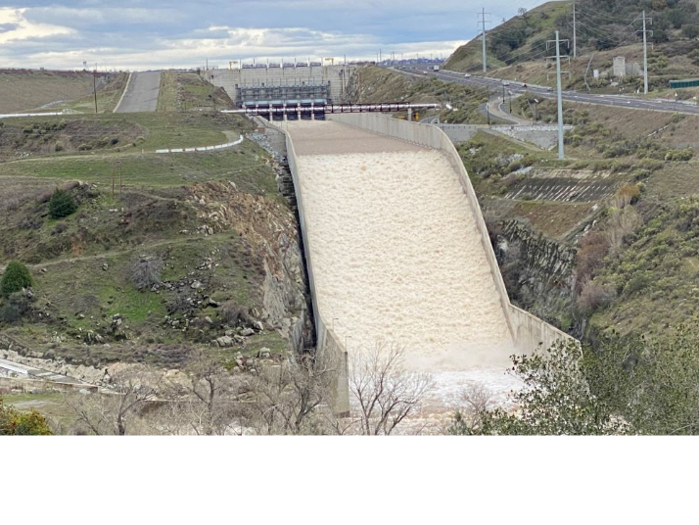
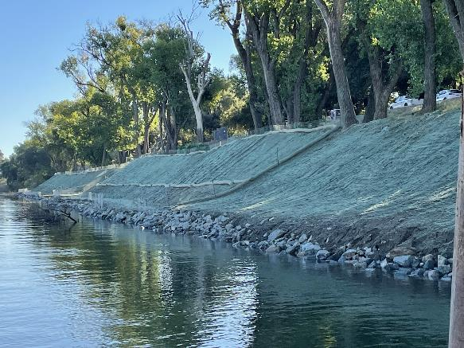
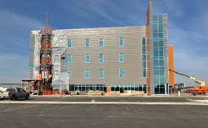
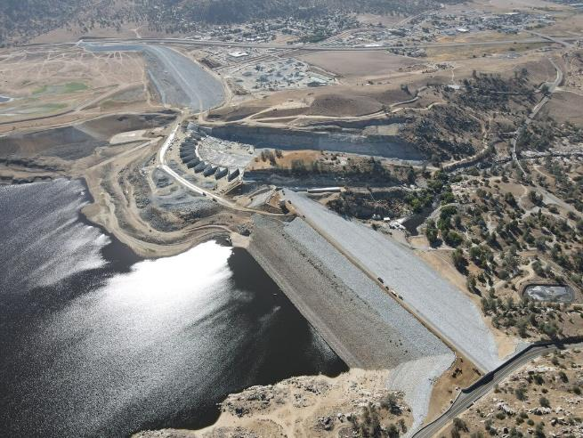
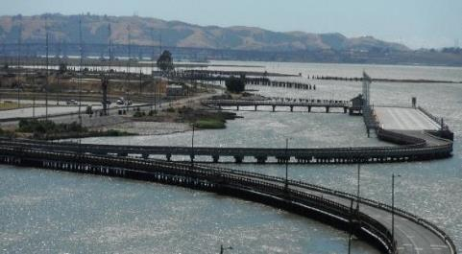
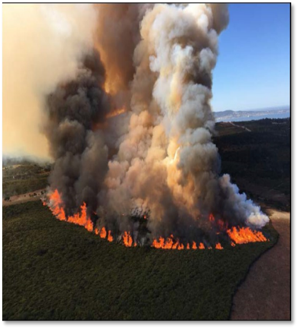
Questions?

Slide 23

HYATT Layout FOR BOOH

Slide 24

Business opportunities open house
Sacramento District – US Army Corps of engineers

